Slide 1
Memory Technologies
Measuring and improving cache performance

Slide 2
Performance…
CPU time can be devided into
Clock cycles the CPU spends in execution
Clock cycle the CPU spends waiting for memory
CPU time = (CPU execution clock cycles + Memory-stall clock cycles)
* Clock cycle time

Slide 3
Memory-Stall, Read-Stall Cycles
Memory-stall clock cycles = (Read-stall cycles + Write-stall cycles)
Read-stall cycles = (Reads/Program) * Read miss rate * Read miss penalty

Slide 4
Write-Stall Cycles
Write-stall cycles= (Writes/Program * Write miss rate * Write miss penalty) + Write buffer stalls

Slide 5
Write-through Cache Org.
Read and Write penalty are the same
If we assume that the write-buffer stalls are negligible
Memory-stall clock cycles= ( Memory accesses / Program) * Miss rate * Miss penalty

Slide 6
Read-Write Same
We can also factor this as
Memory-stall clock cycles = (Instructions/ Program) * (Misses/ Instruction) * Miss penalty

Slide 7
Calculating Cache Performance
Assume the miss rate of an instruction cache is 2% and the miss rate of the data
cache is 4%. If a processor has a CPI of 2 without any memory stalls and the
miss penalty is 100 cycles for all misses, determine how much faster a processor
would run with a perfect cache that never missed. Assume the frequency of all
loads and stores is 36%.

Slide 8
Continue…
Instruction miss cycles = I * 2% * 100 = 2.00 I
Data miss cycles = I * 36% * 4% * 100 = 1.44 I

Slide 9
Continue…
The total number of memory-stall cycles is
= 2.00 I + 1.44 I = 3.44 I.
Accordingly, the total
CPI including memory stalls is = 2 + 3.44 = 5.44

Slide 10
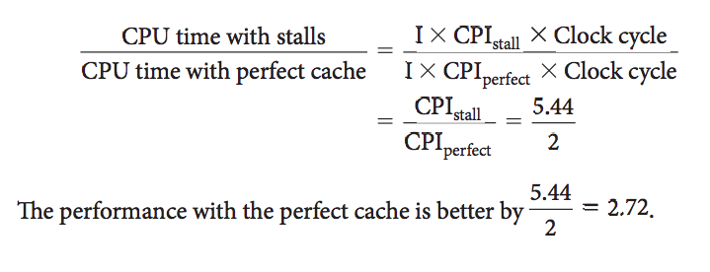
Performance calculation cont…

Slide 11
A Faster Processor
CPI = 1 instead of 2
CPI with cache miss = 1 + 3.44 = 4.44
4.44 time faster
Time spend on memory
63%(3.44/5.44) to 77%(3.44/4.4)

Slide 12
Other Factors
Hit time
Increase in cache size

Slide 13
AMAT
Average Memory Access Time
Average time to access memory considering both hit and miss
AMAT = Time for a hit + Miss rate * Miss penalty

Slide 14
AMAT Example
Find the AMAT for a processor with a 1 ns clock cycle time, a miss penalty of 20 clock cycles, a miss rate of 0.05 misses per instruction, and a cache access time (including hit detection) of 1 clock cycle. Assume that the read and write miss penalties are the same and ignore other write stalls.

Slide 15
AMAT Continue…
AMAT = Time for a hit + Miss rate * Miss penalty
= 1 + 0.05 * 20
= 2 clock cycles
AMAT = 2 * 1 = 2ns
Section 5.15, Fallacies and Pitfalls for more examples

Slide 16
Reducing the Cache Misses
So far we have used direct Mapped
Has a fixed location for each block
Fully Associative

Slide 17
Fully Associative
A cache structure in which a block can be placed in any location in the cache.
To find a given block in a fully associative cache, all the entries in the cache must be searched
Have a separate comparator
Useful for small block size

Slide 18
Set Associative
Several sets
Fixed mapping to a set
But inside set fully associative

Slide 19
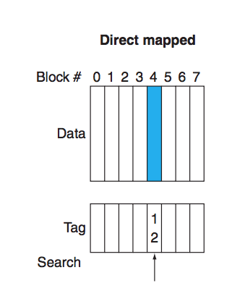
Direct-mapping

Slide 20
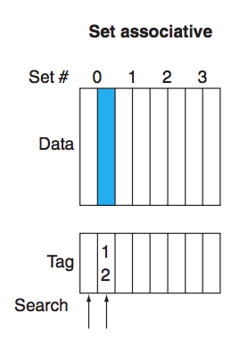
Set-Associative

Slide 21
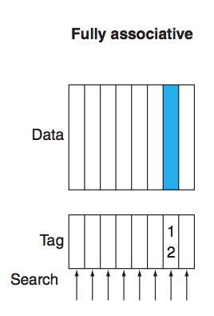
Fully Associative

Slide 22
Everything in terms of Set-Associative
Direct Mapping – One-way set associative
Full Associative – m-way set associative

Slide 23
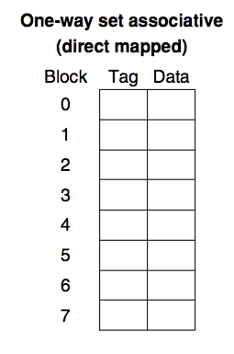
One-way set associative

Slide 24
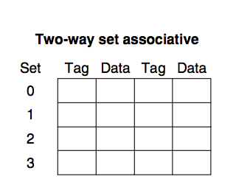
Two-way set associative

Slide 25
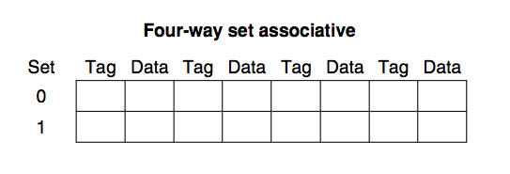
Four-way set associative

Slide 26
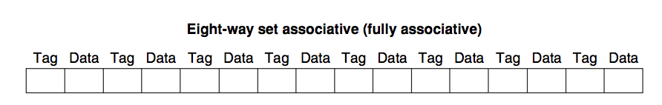
Eight-way (Full) set associative

Slide 27
Pros and Cons
Reduce miss rate
Increate hit time

Slide 28
What Covered
Section 5.4

